Slide 1
Do Less Harm: Evaluation of Programmatic Options in the Face of Reduced Foreign Aid
Transition and Sustainability: Lessons, Questions and Priorities
Emily Hyle, MD MSc
Division of Infectious Diseases
Massachusetts General Hospital
Harvard Medical School
Supported by NIH (K01 HL123349)

Slide 2
Disclosures
I have no financial disclosures

Slide 3
Scale Up Success
UNAIDS Global AIDS Update 2016
Notes:
Scaling up HIV treatment and prevention has been a major priority of research, implementation, and policy
Investments in testing, linkage, treatment, and retention

Slide 4
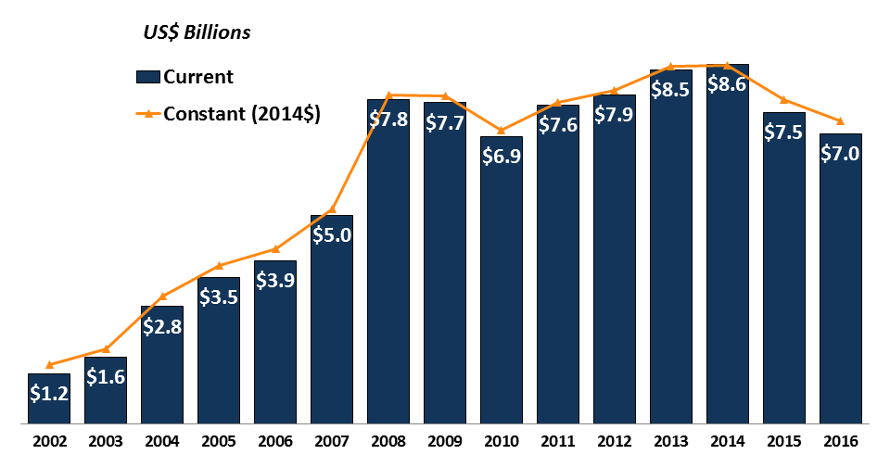
Flat Funding over the Past Decade
Donor Government Disbursements for HIV, Kaiser Family Foundation 2017
Notes:
Since 2008, international funding has plateaued
Providers and policy-makers have been asked to achieve better clinical outcomes with fewer available dollars for more people

Slide 5
Scale Back?!
“Provides sufficient resources to maintain current commitments and all current patient levels on HIV/AIDS treatment under the President’s Emergency Plan for AIDS Relief (PEPFAR) and maintains funding for malaria programs.”
Proposed cuts:
PEPFAR 18%
Global Fund (GFATBM) 17%
$1 billion reduction to State, USAID, and CDC Global Health
White House, Office of Management and Budget 2017

Slide 6
Objective
What is the best strategy to scale back and achieve budget cuts with the least impact on the epidemic and clinical outcomes?
We used a simulation modeling approach to evaluate the epidemiologic, clinical, and budgetary consequences of different HIV program scale back strategies
Walensky et al Ann Int Med 2017

Slide 7
Methods – CEPAC-I Model
We used the Cost-Effectiveness of Preventing AIDS Complications–International (CEPAC-I) microsimulation model
Populated with trial and cohort data
Case studies: South Africa and Côte d’Ivoire
Model outcomes:
Epidemiologic: Transmissions
Clinical: Deaths
Budgetary: $$ saved
Walensky et al Ann Int Med 2017

Slide 8
Current Scale Up
Strategy | Description
Current Scale Up | Enhanced testing, linkage, treatment, and retention
Walensky et al Ann Int Med 2017

Slide 9
Six Scale Back Strategies
**Assumption: commitments to patients already receiving HIV care would continue**
Strategy | Description
Current Scale Up | Enhanced testing, linkage, treatment, and retention
1. No New ART | Ongoing care only for established patients
2. Late Presentation | Reduced testing, so patients present at low CD4
3. Reduced ART Eligibility | ART initiated only when CD4 <350 cells/µL
4. Reduced Retention | 84% now, decreasing to 70% at 5 years
5. No VL Monitoring | CD4 monitoring only
6. No 2nd-line ART | One ART regimen only
Walensky et al Ann Int Med 2017

Slide 10
South Africa: Projected Outcomes at 10 Years
Strategy |  | Transmissions (n) | Deaths (n) | Budget ($ million)
Current Scale Up |  | 3,240,000 | 4,258,000 | 32,180
Walensky et al Ann Int Med 2017

Slide 11
South Africa: Projected Outcomes at 10 Years
Strategy |  | Transmissions (n) | Deaths (n) | Budget ($ million)
Current Scale Up |  | 3,240,000 | 4,258,000 | 32,180
 |  | Additional Transmissions | Additional Deaths | Budget Savings ($ million (%))
1. No New ART | 630,000 |  | 1,664,000 | 7,740 (24%)
Walensky et al Ann Int Med 2017

Slide 12
South Africa: Projected Outcomes at 10 Years
Strategy |  | Transmissions (n) | Deaths (n) | Budget ($ million)
Current Scale Up |  | 3,240,000 | 4,258,000 | 32,180
 |  | Additional Transmissions | Additional Deaths | Budget Savings ($ million (%))
1. No New ART | 630,000 |  | 1,664,000 | 7,740 (24%)
2. Late Presentation | 470,000 |  | 945,000 | 4,290 (13%)
3. Reduced ART Eligibility | 213,000 |  | 91,000 | 50 (0.2%)
4. Reduced Retention | 188,000 |  | 308,000 | 1,040 (3%)
5. No VL Monitoring | 206,000 |  | 46,000 | -320 (+1%)
6. No 2nd-line ART | 38,000 |  | 31,000 | 50 (0.2%)
Walensky et al Ann Int Med 2017

Slide 13
South Africa: Projected Outcomes at 10 Years
Strategy |  | Transmissions (n) | Deaths (n) | Budget ($ million)
Current Scale Up |  | 3,240,000 | 4,258,000 | 32,180
 |  | Additional Transmissions | Additional Deaths | Budget Savings ($ million (%))
1. No New ART | 630,000 |  | 1,664,000 | 7,740 (24%)
2. Late Presentation | 470,000 |  | 945,000 | 4,290 (13%)
3. Reduced ART Eligibility | 213,000 |  | 91,000 | 50 (0.2%)
4. Reduced Retention | 188,000 |  | 308,000 | 1,040 (3%)
5. No VL Monitoring | 206,000 |  | 46,000 | -320 (+1%)
6. No 2nd-line ART | 38,000 |  | 31,000 | 50 (0.2%)
Walensky et al Ann Int Med 2017

Slide 14
South Africa: Projected Outcomes at 10 Years
Strategy |  | Transmissions (n) | Deaths (n) | Budget ($ million)
Current Scale Up |  | 3,240,000 | 4,258,000 | 32,180
 |  | Additional Transmissions | Additional Deaths | Budget Savings ($ million (%))
1. No New ART | 630,000 |  | 1,664,000 | 7,740 (24%)
2. Late Presentation | 470,000 |  | 945,000 | 4,290 (13%)
3. Reduced ART Eligibility | 213,000 |  | 91,000 | 50 (0.2%)
4. Reduced Retention | 188,000 |  | 308,000 | 1,040 (3%)
5. No VL Monitoring | 206,000 |  | 46,000 | -320 (+1%)
6. No 2nd-line ART | 38,000 |  | 31,000 | 50 (0.2%)
Walensky et al Ann Int Med 2017

Slide 15
Scale Back Strategies in Combination
Scale back strategies can have synergies or antagonisms when deployed in combination
We also compared projected outcomes between
The sum of model outcomes for two scale back strategies alone
Model outcomes when two scale back strategies were used in combination

Slide 16
Reducing Both ART Eligibility and Retention
Strategy | Transmissions (n) | Deaths (n) | Budget ($ million)
Current Scale Up | 3,240,000 | 4,258,000 | 32,180
 | Additional Transmissions | Additional Deaths | Budget Savings ($ million (%))
3. Reduced ART Eligibility | 213,000 | 91,000 | 50 (0.2%)
4. Reduced Retention | 188,000 | 308,000 | 1,040 (3%)
Sum of Individual Strategies | 401,000 | 399,000 | 1,090 (3%)
In Combination | 390,000 | 395,000 | 1,050 (3%)
** The impact of both strategies in combination is the same as individually **
Walensky et al Ann Int Med 2017

Slide 17
Late Presentation and Reduced ART Eligibility
Strategy | Transmissions (n) | Deaths (n) | Budget ($ million)
Current Scale Up | 3,240,000 | 4,258,000 | 32,180
 | Additional Transmissions | Additional Deaths | Budget Savings ($ million (%))
2. Late Presentation | 470,000 | 945,000 | 4,290 (13%)
3. Reduced ART Eligibility | 213,000 | 91,000 | 50 (<0.1%)
Sum of Individual Strategies | 683,000 | 1,036,000 | 4,340 (13%)
In Combination | 493,000 | 959,000 | 4,310 (13%)
** Strategies in combination have reduced clinical downside than individually**
Walensky et al Ann Int Med 2017

Slide 18
No VL Monitoring and No 2nd-line ART
Strategy | Transmissions (n) | Deaths (n) | Budget ($ million)
Current Scale Up | 3,240,000 | 4,258,000 | 32,180
 | Additional Transmissions | Additional Deaths | Budget Savings ($ million (%))
5. No VL Monitoring | 206,000 | 46,000 | -320 (+1%)
6. No 2nd-line ART | 38,000 | 31,000 | 50 (0.2%)
Sum of Individual Strategies | 244,000 | 77,000 | -270 (+1%)
In Combination | 234,000 | 69,000 | -80 (+0.2%)
** Strategies in combination have less budgetary impact than individually**
Walensky et al Ann Int Med 2017

Slide 19
Impact Will Differ Among Recipient Nations
A 10% cut in PEPFAR funding
 | South Africa | Côte d’Ivoire
Percentage of overall HIV budget (%) | 2% | 9%
Reduction in absolute budget ($) | $40M | $20M
HIV prevalence (%) | 19.2% | 3.2%
Number of PWH affected (n) | 6.7 million | 440,000
Walensky et al Ann Int Med 2017

Slide 20
Projected $ Per Year of Life Lost
For every year of life lost in South Africa and Côte d’Ivoire, HIV programs will save ~$600-$900
Does imposing such tradeoffs on vulnerable populations accurately reflect how donor countries value life in recipient nations?

Slide 21
Conclusions
Reduced funding for HIV prevention and treatment will have enormous consequences for the epidemic and for people with HIV, with only modest budgetary savings
Simulation modeling can assist in highlighting the tradeoffs of difficult choices in policy-making and investments
Further research is needed to optimize efficiencies in care and to minimize clinical harms if budget cuts are unavoidable

Slide 22
Thank You
United States
Ingrid Bassett, MD, MPH
Ethan Borre
Andrea Ciaranello, MD, MPH
Sydney Costantini
Caitlin Dugdale, MD
Kenneth Freedberg, MD, MSc
Gregg Gonsalves, PhD
Emily Hyle, MD, MSc
Emily Martey
Lucia Millham
Anne Neilan, MD, MPH
A. David Paltiel, PhD
Robert Parker, ScD
Krishna Reddy, MD
Supported by:
National Institute of Allergy and Infectious Disease (R01 AI058736, R37 AI093269)
National Heart, Lung, and Blood Institute
(EPH - K01 HL123349)
Steve and Deborah Gorlin Massachusetts General Hospital Research Scholars Award (RPW)
Justine Scott, MPH
Madeleine Stern
Rochelle Walensky, MD, MPH
Milton Weinstein, PhD
South Africa
Linda-Gail Bekker, MBChB, PhD
Robin Wood, BMBCh, DSc
Côte d’Ivoire
Xavier Anglaret, MD, PhD
Christine Danel, MD
Serge Eholié, MD, PhD
Eric Ouattara, MD, MPH
Eugène Messou, MD

Slide 23
Supplementary Slides

Slide 24
Cascade of Care
Undiagnosed
Diagnosed
1st-line ART
2nd-line ART
Testing
Linkage
Viral Load
In Care
Out of Care

Slide 25
Strategy 1 – No New ART
Undiagnosed
Diagnosed
1st-line ART
2nd-line ART
Testing
Linkage
Viral Load
In Care
Out of Care

Slide 26
Strategy 2 – Late Presentation
Undiagnosed
Diagnosed
1st-line ART
2nd-line ART
Testing
Linkage
Viral Load
In Care
Out of Care

Slide 27
Strategy 3 – Reduced ART Eligibility
Undiagnosed
Diagnosed
1st-line ART
2nd-line ART
Testing
Linkage
Viral Load
In Care
Out of Care

Slide 28
Strategy 4 – Reduced Retention
Undiagnosed
Diagnosed
1st-line ART
2nd-line ART
Testing
Linkage
Viral Load
In Care
Out of Care

Slide 29
Strategy 5 – No VL Monitoring
Undiagnosed
Diagnosed
1st-line ART
2nd-line ART
CD4
Testing
Linkage
Viral Load
In Care
Out of Care

Slide 30
Strategy 6 – No 2nd-line ART
Undiagnosed
Diagnosed
1st-line ART
2nd-line ART
1st-line resuppression
Testing
Linkage
In Care
Out of Care

Slide 31
Reducing Both ART Eligibility and Retention
Undiagnosed
Diagnosed
1st-line ART
2nd-line ART
Testing
Linkage
Viral Load
In Care
Out of Care

Slide 32
Late Presentation and Reduced ART Eligibility
Undiagnosed
Diagnosed
1st-line ART
2nd-line ART
Testing
Linkage
Viral Load
In Care
Out of Care

Slide 33
No VL Monitoring and No 2nd-line ART
Undiagnosed
Diagnosed
1st-line ART
2nd-line ART
CD4
Testing
Linkage
Viral Load
In Care
Out of Care

